Slide 1
La voie de signalisation Wnt et son implication dans la progression des carcinomes mammaires
27ème Congrès National de Cancérologie et de Radiothérapie
22 Novembre 2024, Hotel Kantaoui Bey, Hammam Sousse
Pr Elham HASSEN
Laboratoire de Recherche d’Immuno-Oncologie Moléculaire (LR99ES28)

Slide 2
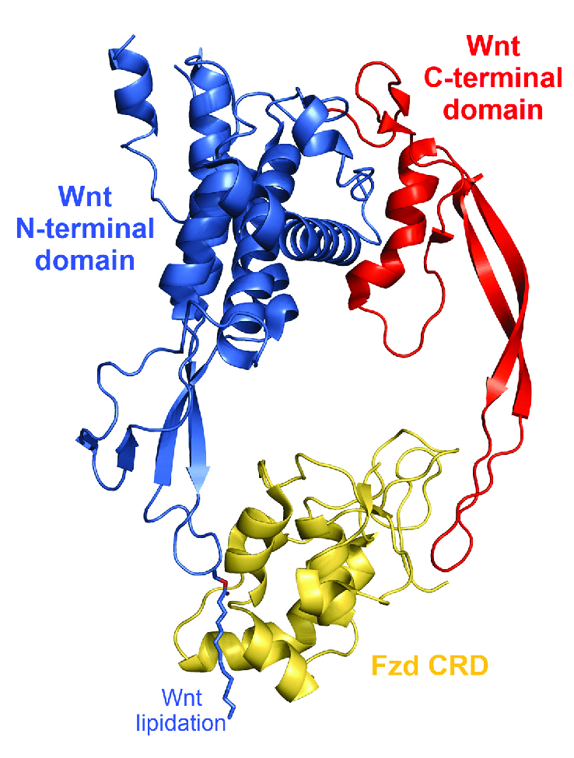
La voie de signalisation Wnt
Voie de signalisation intracellulaire très conservée
Impliquée dans le développement embryonnaire
Rôle primordiale dans l'homéostasie tissulaire et l’angiogenèse
Le dysfonctionnement de cette voie de signalisation est impliqué dans de nombreux cancers chez l’homme.
L’activation de cette voie nécessite la sécrétion de molécules de la famille des Wnt qui contrôlent le destin d’une cellule : polarité, différenciation, croissance,...
le ligand Wnt active la voie de signalisation à travers sa liaison aux récepteurx Frizzleds
Crystal structure complex of the Xenopus Wnt8 with the mouse Fzd8 cysteine-rich domain (PDB 4F0A)

Slide 3
La β-caténine: une molécule à double rôle
La β-caténine joue un rôle dans l’adhérence cellulaire par son association avec la cadhérine E et l’actine du cytosquelette pour former les jonctions d’adhérence (gap jonction)
Une autre fraction de la β-caténine “libre” est véhiculée dans le noyau où elle s’associe à des facteurs de transcription
Notes:
Fig. 1 | Mechanisms of Wnt signalling. a | Canonical Wnt signalling is inactive in the absence of Wnt ligands (Wnt off). In this state, β-catenin is located in adherent junctions and cytoplasm of the cell, where it becomes phosphorylated by the destruction complex (comprising adenomatous polyposis coli protein (APC), Axin, casein kinase I isoform-α (CK1α) and glycogen synthase kinase 3β (GSK3β)) and targeted for proteasomal degradation. b | Wnt signalling is active in the presence of Wnt ligands (Wnt on), which bind to the FZD–LRP5–LRP6 co-receptor. Subsequent LRP6 phosphorylation then leads to Axin and Dishevelled (DVL) recruitment, which blocks Axin-mediated phosphorylation of β-catenin and thereby prevents β-catenin degradation, enabling its accumulation and nuclear translocation. In the nucleus, β-catenin binds to diverse co-effectors, regulating the expression of genes involved in different cellular processes. βTRCP, E3 ubiquitin ligase subunit βTRCP; CK1γ, casein kinase I isoform-γ; EMT, epithelial–mesenchymal transition; FZD, Frizzled; FOXO, forkhead box protein O; HIF1α, hypoxia-inducible factor 1α; LEF, lymphoid enhancer-binding factor; LRP, low-density lipoprotein receptor-related protein; TCF, T cell factor. https://doi.org/10.1038/s41575-018-0075-9. Wnt–β-catenin signalling in liver development, health and disease. 2018

Slide 4
La voie de signalisation Wnt/β-caténine
Notes:
Fig. 1 | Mechanisms of Wnt signalling. a | Canonical Wnt signalling is inactive in the absence of Wnt ligands (Wnt off). In this state, β-catenin is located in adherent junctions and cytoplasm of the cell, where it becomes phosphorylated by the destruction complex (comprising adenomatous polyposis coli protein (APC), Axin, casein kinase I isoform-α (CK1α) and glycogen synthase kinase 3β (GSK3β)) and targeted for proteasomal degradation. b | Wnt signalling is active in the presence of Wnt ligands (Wnt on), which bind to the FZD–LRP5–LRP6 co-receptor. Subsequent LRP6 phosphorylation then leads to Axin and Dishevelled (DVL) recruitment, which blocks Axin-mediated phosphorylation of β-catenin and thereby prevents β-catenin degradation, enabling its accumulation and nuclear translocation. In the nucleus, β-catenin binds to diverse co-effectors, regulating the expression of genes involved in different cellular processes. βTRCP, E3 ubiquitin ligase subunit βTRCP; CK1γ, casein kinase I isoform-γ; EMT, epithelial–mesenchymal transition; FZD, Frizzled; FOXO, forkhead box protein O; HIF1α, hypoxia-inducible factor 1α; LEF, lymphoid enhancer-binding factor; LRP, low-density lipoprotein receptor-related protein; TCF, T cell factor. https://doi.org/10.1038/s41575-018-0075-9. Wnt–β-catenin signalling in liver development, health and disease. 2018

Slide 5
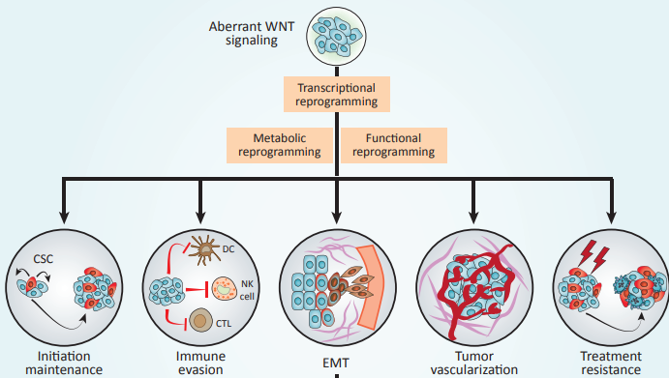
Dysfonctionnement de la voie Wnt/β-caténine
Notes:
Figure 2. WNT Signaling and Cancer. Deregulated WNT signaling in the tumor microenvironment supports malignant transformation and disease progression via a variety of mechanisms, including (but not limited to) (i) improved fitness of the cancer stem cell (CSC) compartment; (ii) evasion of tumor-targeting immune responses; (iii) activation of the epithelial-tomesenchymal transition (EMT); (iv) accrued neo-vascularization; and (v) increased resistance to a variety of treatment modalities. CTL, cytotoxic T lymphocyte; DC, dendritic cell; NK, natural killer.

Slide 6
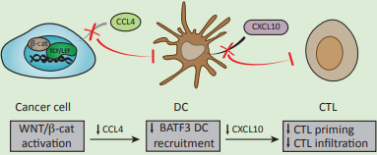
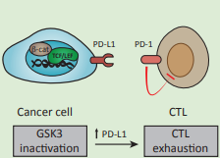
Échappement Immunitaire via la voie Wnt/β-caténine
Galluzzi L, Spranger S, Fuchs E, López-Soto A. WNT Signaling in Cancer Immunosurveillance, Trends in Cell Biology, Volume 29, Issue 1,2019.
Notes:
Lorenzo Galluzzi, Stefani Spranger, Elaine Fuchs, Alejandro López-Soto,
WNT Signaling in Cancer Immunosurveillance,
Trends in Cell Biology,
Volume 29, Issue 1,
2019,
Pages 44-65,
that is required for the recruitment of basic leucine zipper ATF-like transcription factor 3 (BATF3)-dependent dendritic cells (DCs) to the tumor microenvironment. This results in reduced levels of DC-derived C-X-C motif chemokine ligand 10 (CXCL10) and limited CD8+ cytotoxic T cell (CTL) infiltration and hence defective cross-priming. Inhibition of glycogen synthase kinase 3 (GSK3) in cancer cells promotes b-catenin activation and consequent stabilization of programmed cell death ligand 1 (PD-L1) that drives CTL exhaustion upon interaction with PD-1. The secretion of dickkopf WNT signaling pathway inhibitor 1 (DKK1) by latent metastatic cells prevents natural killer (NK) cell-dependent cancer cell lysis by reducing the expression of NK cell activating ligands (NKALs) that engage NK cell activatory receptors (NKARs). (B) Canonical WNT/b-catenin in myeloid-derived suppressor cells (MDSCs) inhibits their accumulation and ability to infiltrate malignant lesions, resulting in increased recruitment of CTLs. GSK3 inhibition and b-catenin overexpression in NK cells result in the upregulation of transcription factors responsible for NK cell maturation, hence stimulating NK cell effector function. While enforced expression of b-catenin favors regulatory T (TREG) cell survival in vitro, activation of transcription factor 1 (TCF1, encoded by TCF7) downstream of canonical WNT signaling impairs the immunosuppressive activity of TREG cells by blocking forkhead box P3 (FOXP3) transcriptional functions. (C) WNT ligands released by cancer cells can induce canonical WNT signaling in DCs, resulting in increased secretion of interleukin 10 (IL-10), limited production of IL-12, and upregulation of indoleamine 2,3-dioxygenase 1 (IDO1). This favors the generation of TREG cells and consequent inhibition of CTL activity.

Slide 7
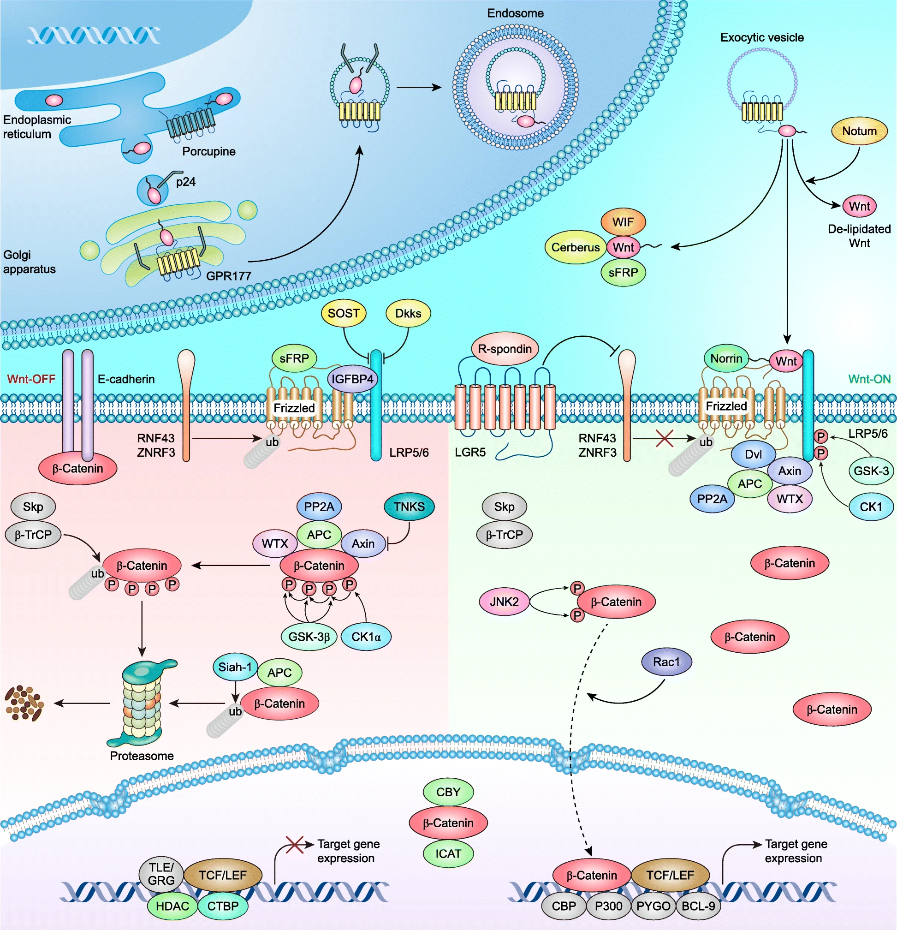
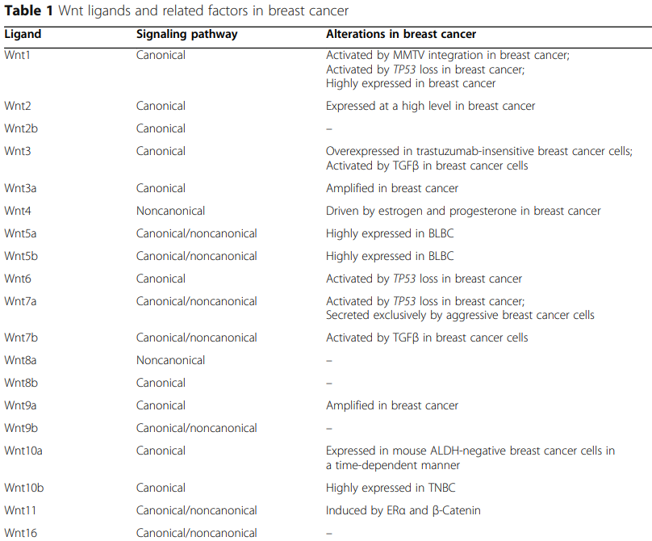
Wnt et Cancer du sein
Xu, X., Zhang, M., Xu, F. et al. Wnt signaling in breast cancer: biological mechanisms, challenges and opportunities. Mol Cancer 19, 165 (2020).

Slide 8
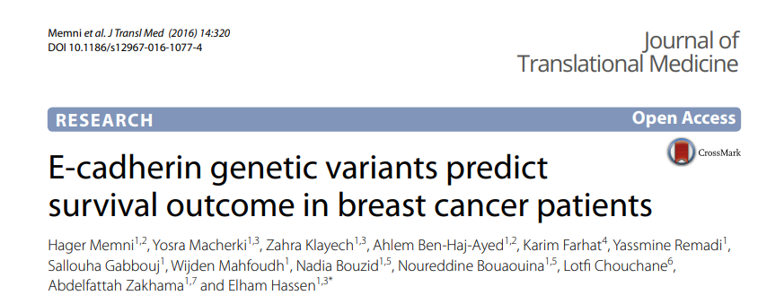

Slide 9
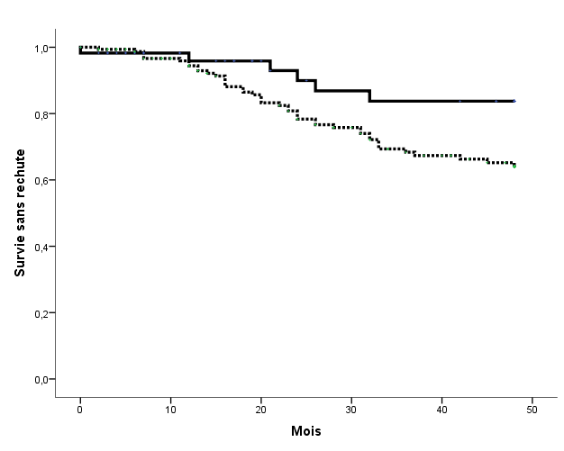
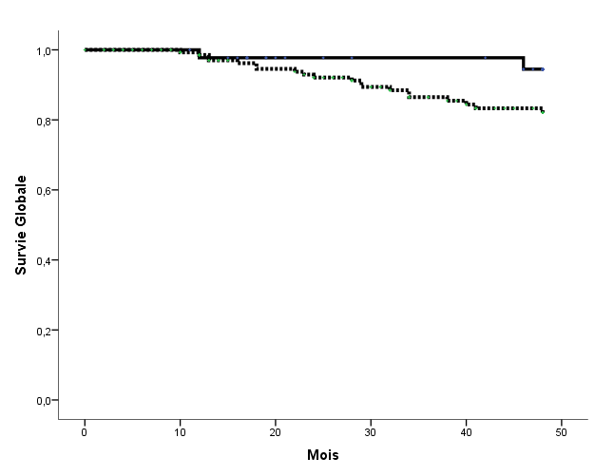
Polymorphisme rs3864004 G/A du gène CTNNB1
une baisse de la dégradation de la β-caténine pour l’allèle A
GG
GG
GA/AA
GA/AA
P<0.03
P< 0.08

Slide 10
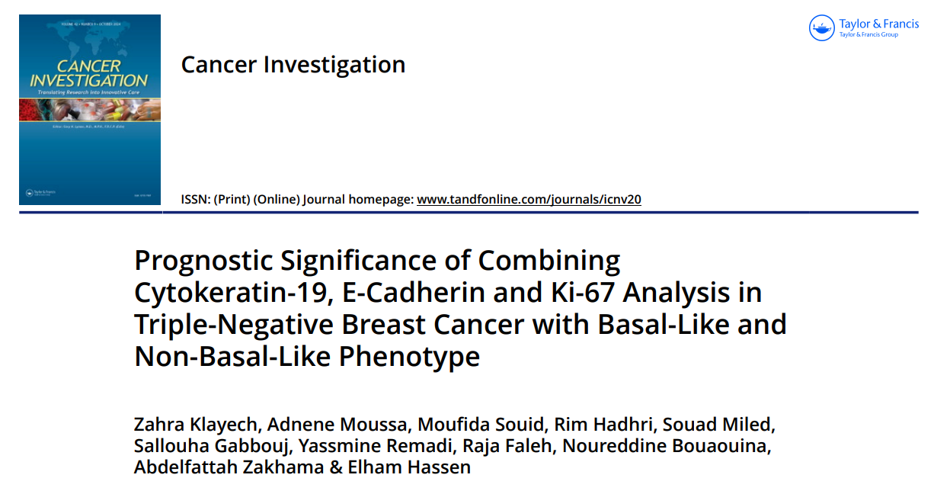
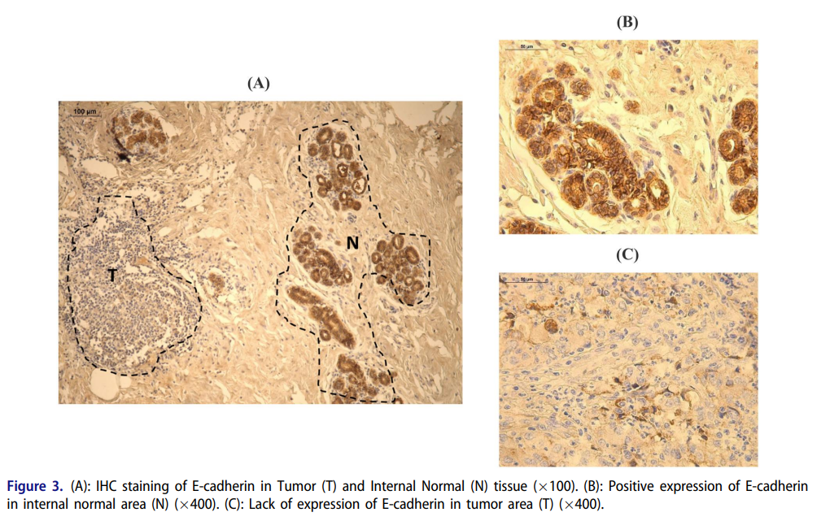
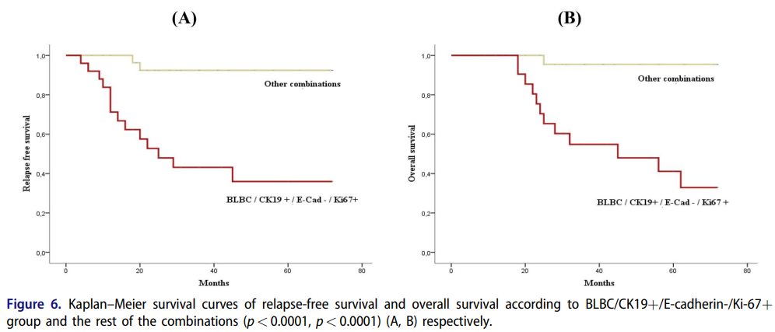
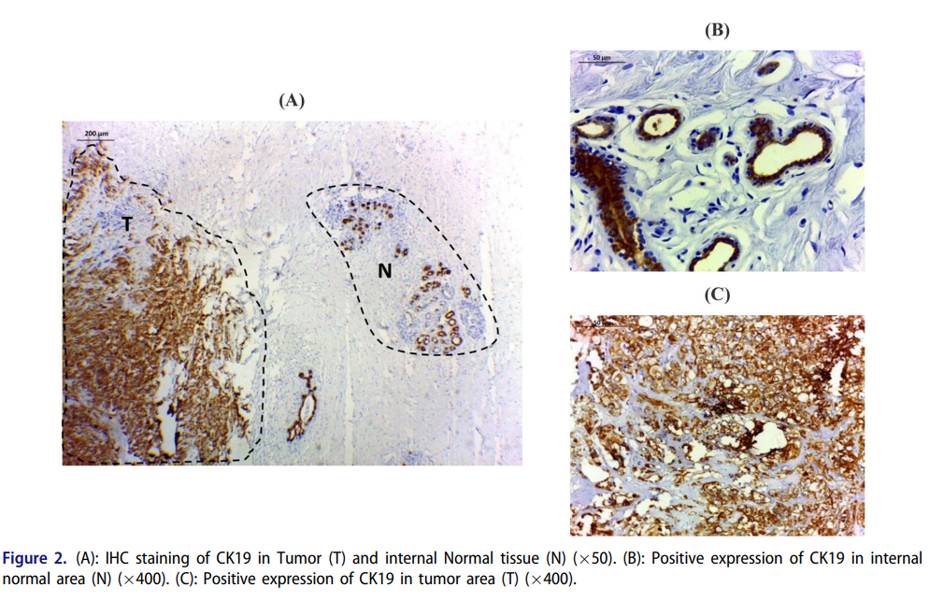

Slide 11
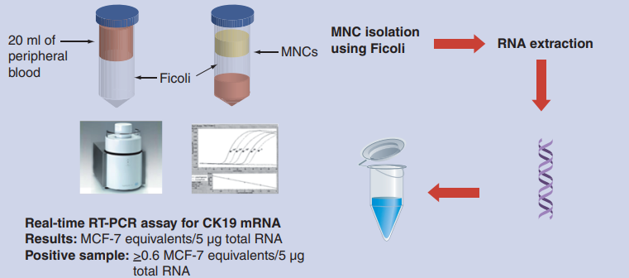
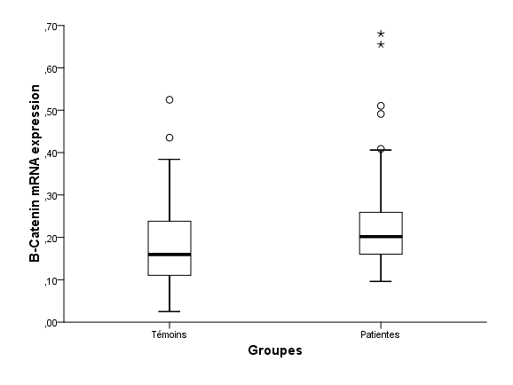
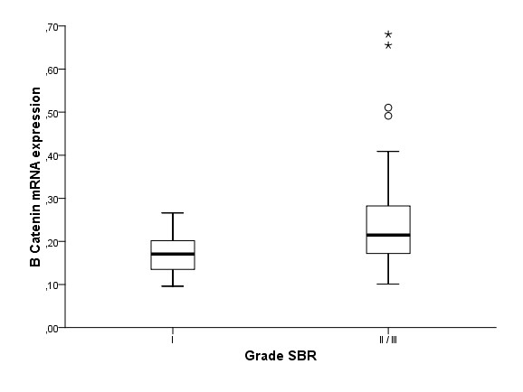
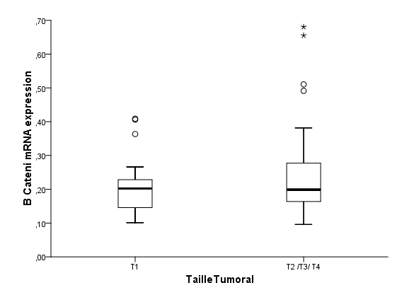
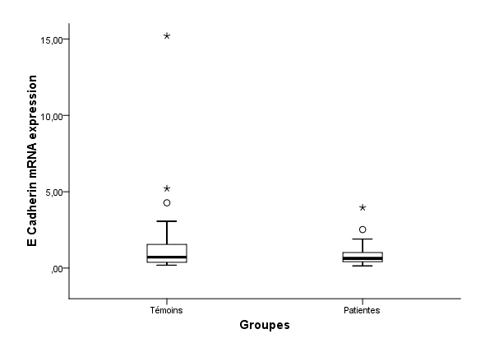
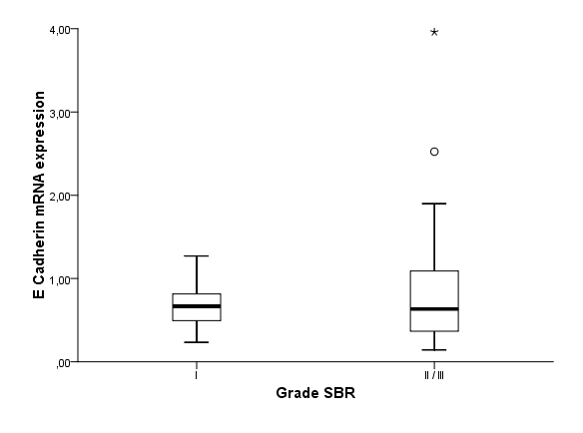
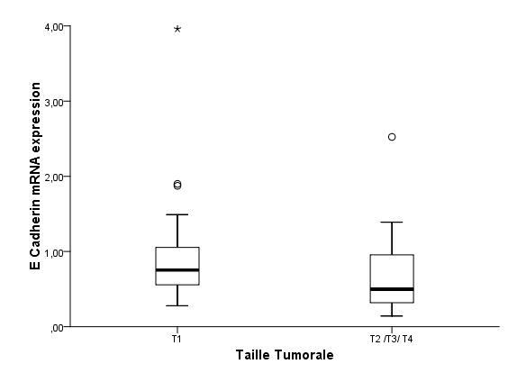
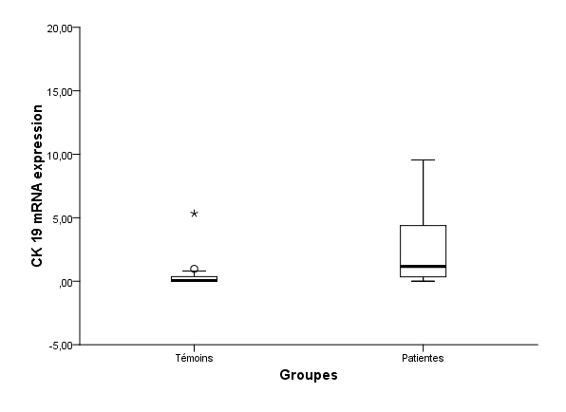
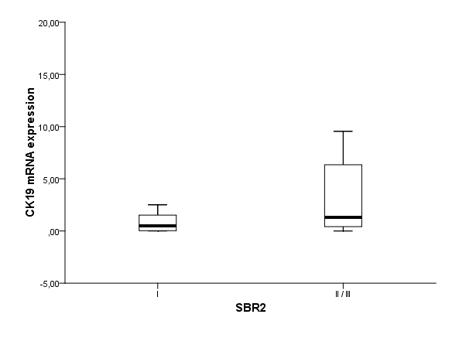
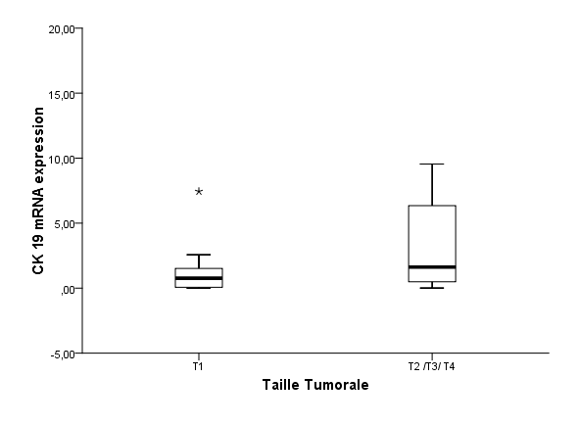
Expression génique dans les Cellules Tumorale Circulantes CTC
P < 0.03
P = 0.01
P < 0.5
β-caténine
P < 0.6
P < 0.7
P < 0.05
E-cadhérine
P < 0.001
CK19
P < 0.03
P < 0.01

Slide 12
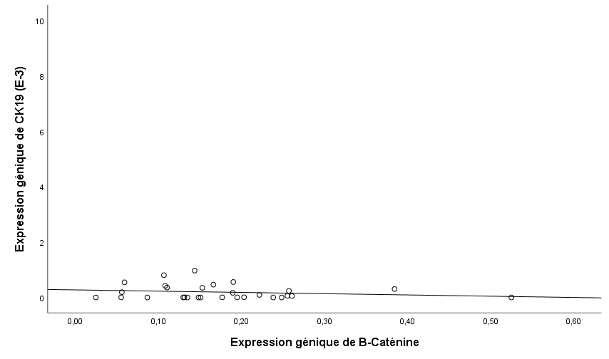
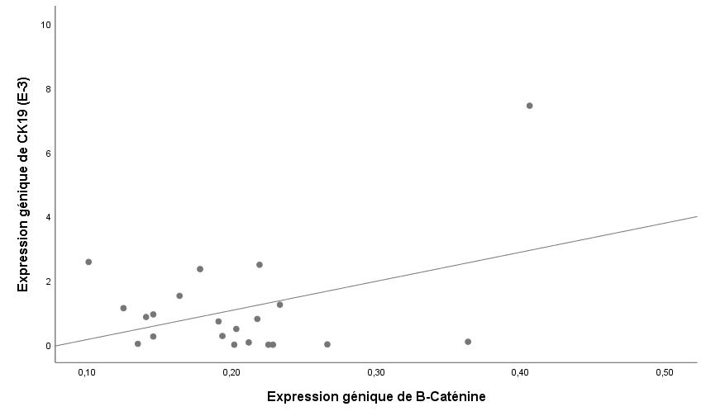
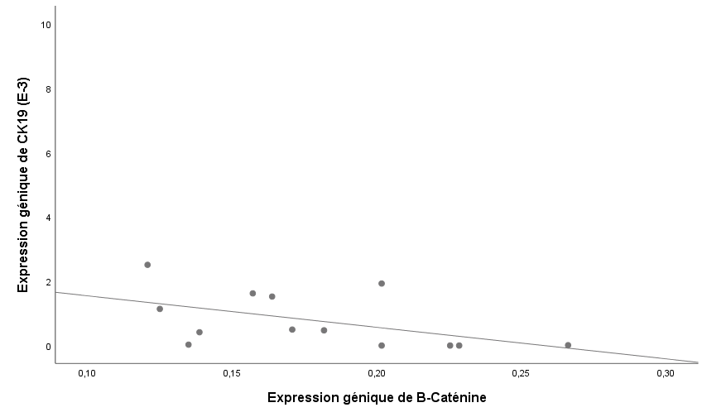
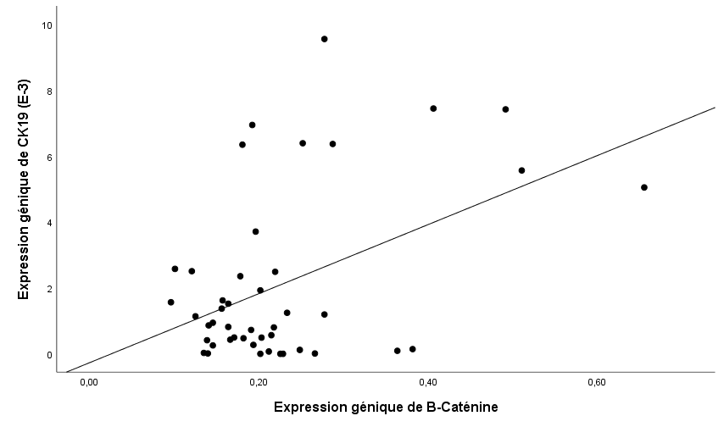
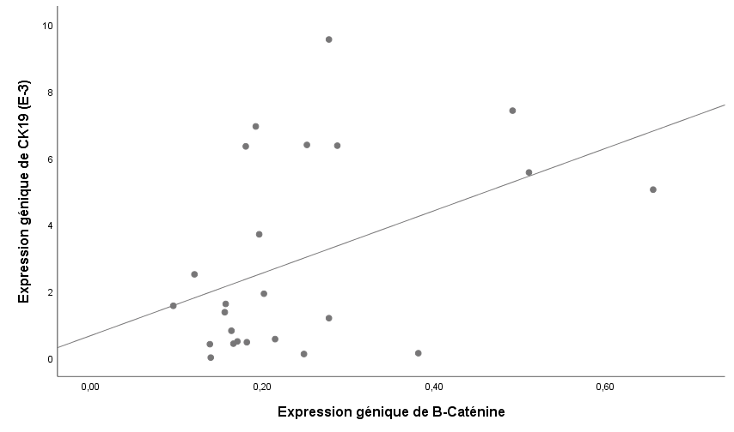
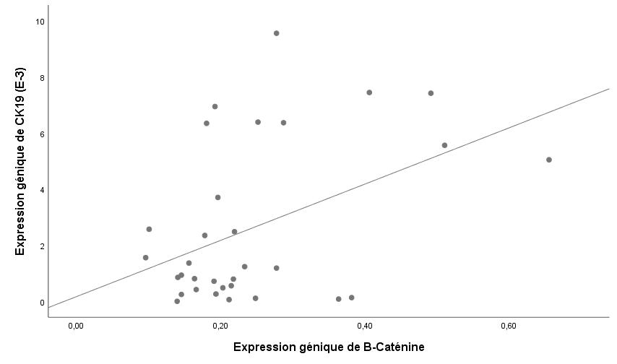
Expression génique CTC
T1
SBR-I
p=0,9
Témoins
p=0,3
p= 0.02
SBR-II-III
p=0,07
Patientes
T-2-3-4
p=0.01
p= 0.01

Slide 13
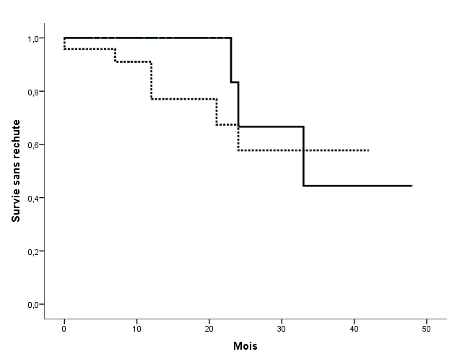
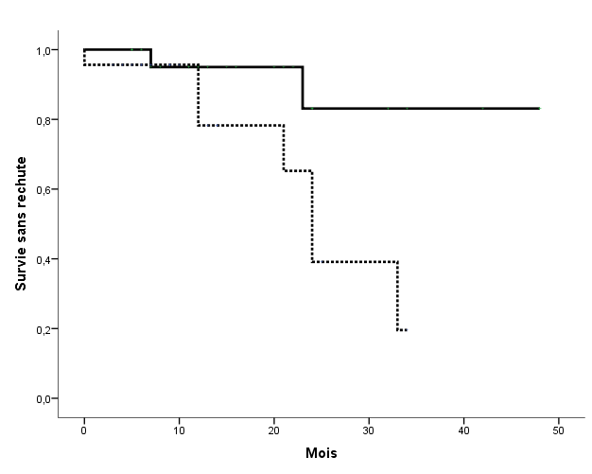
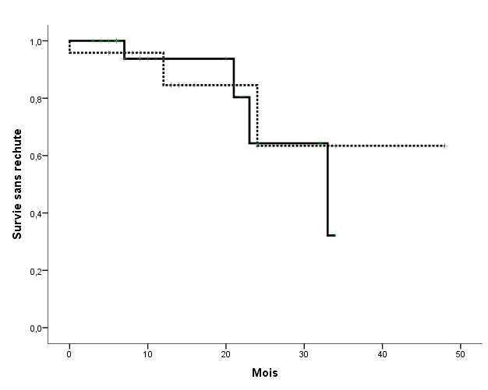
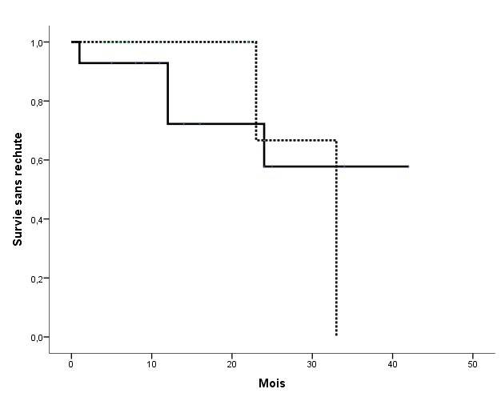
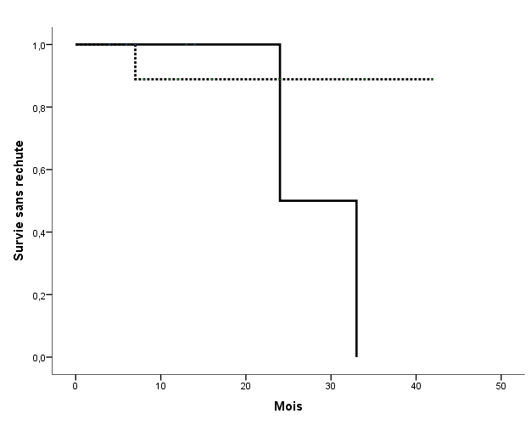
Expression génique CTC
E-Cad high
E-Cad low
B-Cat low
B-Cat high
CK19 low
CK19 high
p<0.4
p<0.02
p<0.6
B-Cat low/E-Cad high
B-Cat high/E-Cad low
B-Cat low/CK19 low
B-Cat high/CK19 high
p<0.2
p<0.8

Slide 14
Xu, X., Zhang, M., Xu, F. et al. Wnt signaling in breast cancer: biological mechanisms, challenges and opportunities. Mol Cancer 19, 165 (2020).

Slide 15
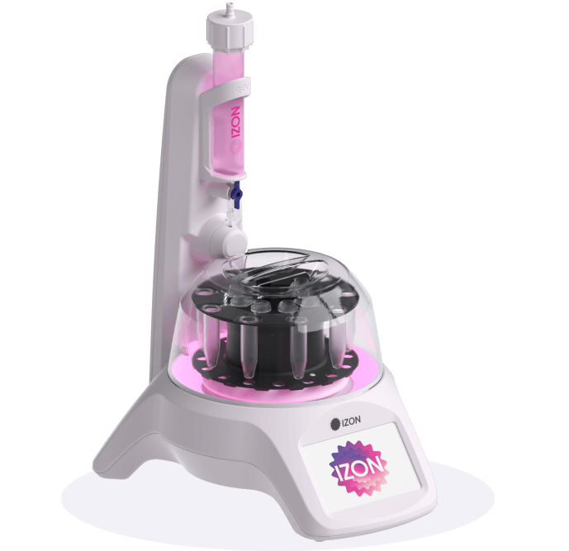
Isolement des Vésicules Extracellulaires (VEs) plasmatiques
10000g
20min
500µL
2500g
10min
Plasma
VEs
Chromatographie d'exclusion de taille
Quantification des VEs plasmatique : VideoDrop
Le principe de vidéos Drop (la microscopie interférométrique d'imagerie) est basé sur un microscope à transmission à fond clair utilisé comme interférométrie homodyne pour détecter, compter et suivre les nanoparticules

Slide 16
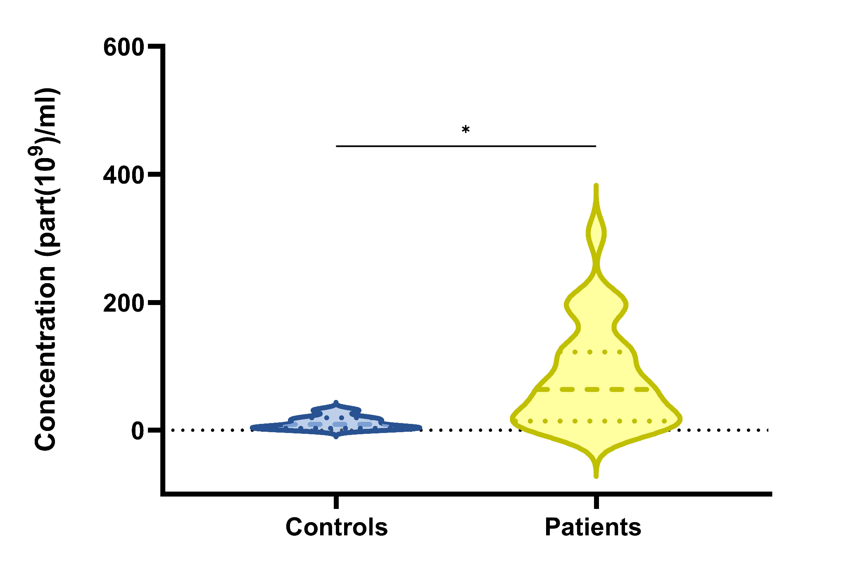
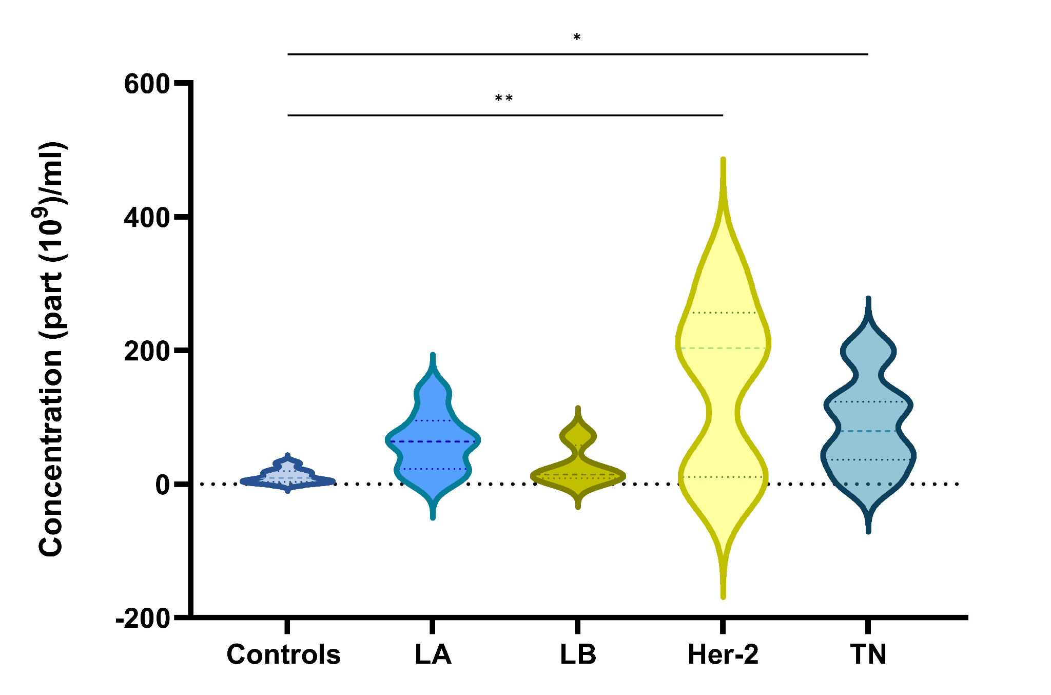
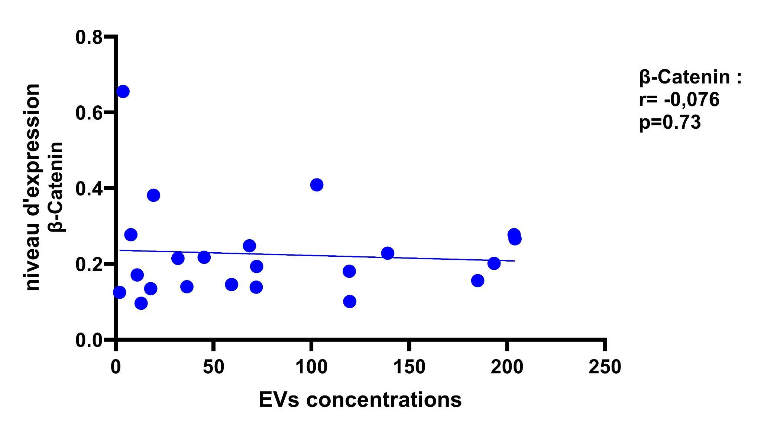
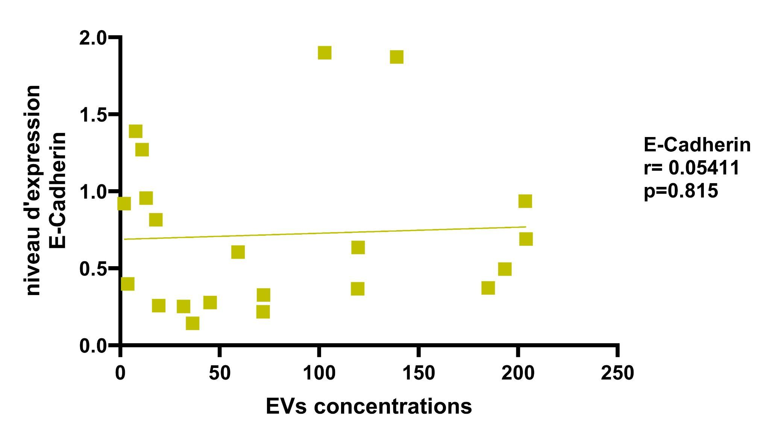
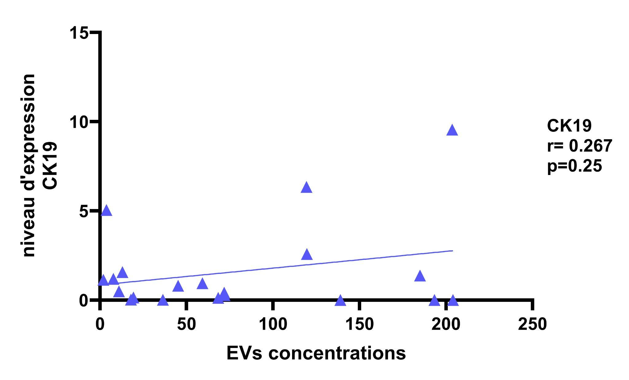
Concentration des Vésicules Extracellulaires (VEs) plasmatiques

Slide 17
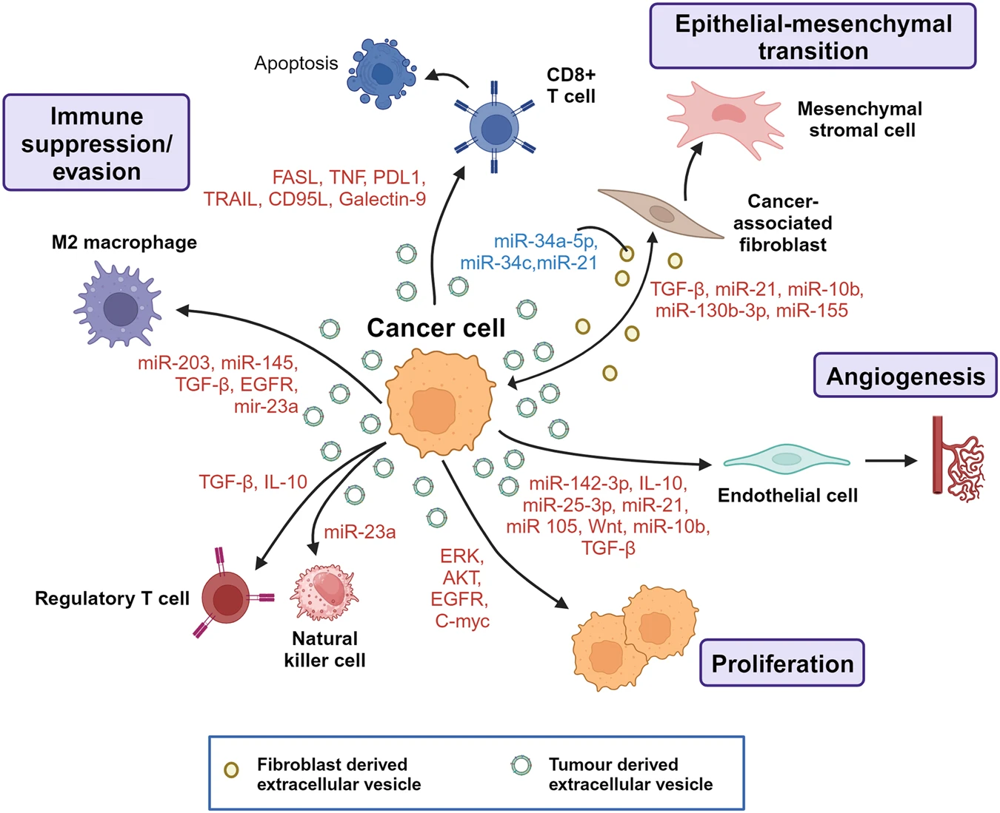
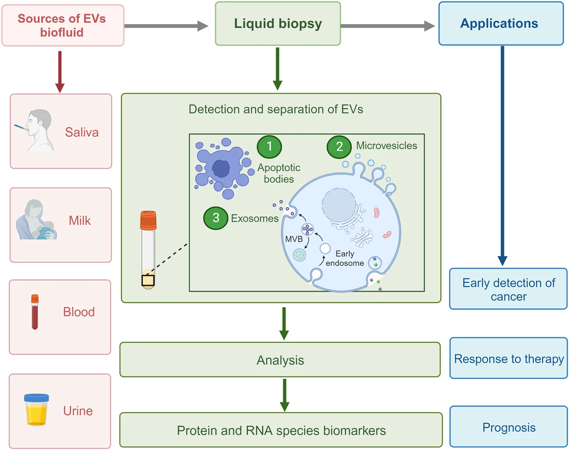
Les VEs cibles et outils
Kumar, M.A., Baba, S.K., Sadida, H.Q. et al. Extracellular vesicles as tools and targets in therapy for diseases. Sig Transduct Target Ther 9, 27 (2024).

Slide 18
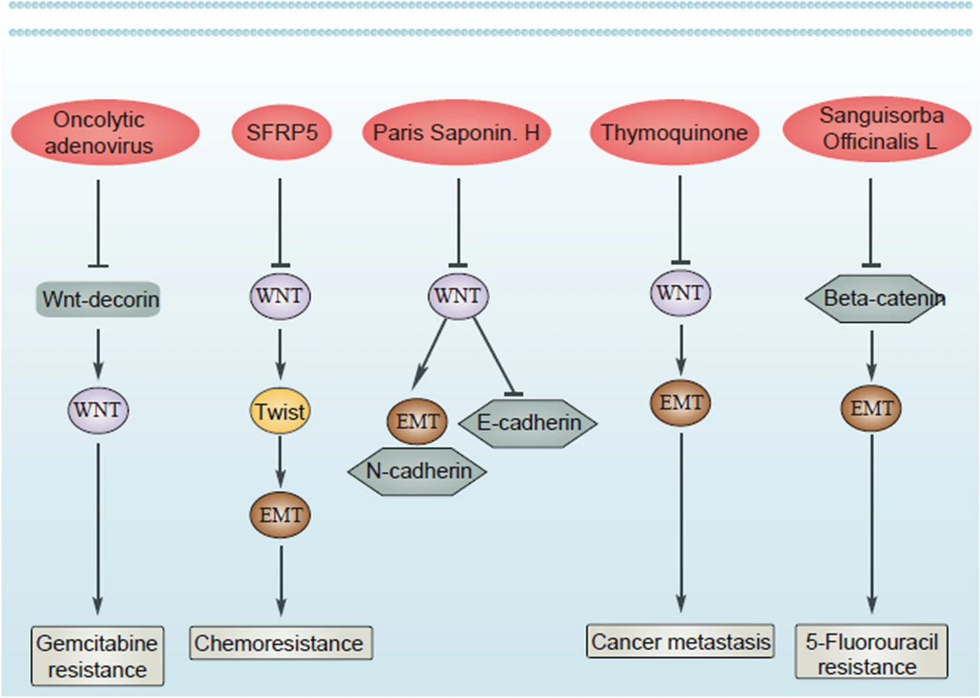
La voie Wnt/β-caténine une cible thérapeutique
Xue, W., Yang, L., Chen, C. et al. Wnt/β-catenin-driven EMT regulation in human cancers. Cell. Mol. Life Sci. 81, 79 (2024).
Notes:
The role of Wnt/EMT in cancer drug resistance and its suppression by anti-cancer drugs. The application of oncolytic adenovirus allows to suppress the Wnt/EMT axis for reversing gemcitabine resistance. When Wnt expression increases, it stimulates Twist/EMT axis in mediating drug resistance. Moreover, suppression of Wnt by thymoquinone and other compounds can prevent cancer metastasis and chemoresistance. Cite this article
Xue, W., Yang, L., Chen, C. et al. Wnt/β-catenin-driven EMT regulation in human cancers. Cell. Mol. Life Sci. 81, 79 (2024). https://doi.org/10.1007/s00018-023-05099-7
. Recently, TQ has been applied in the treatment of bladder cancer and by inhibiting Wnt/β-catenin/EMT axis, the metastasis of tumor cells signifcantly reduces [167].

Slide 19
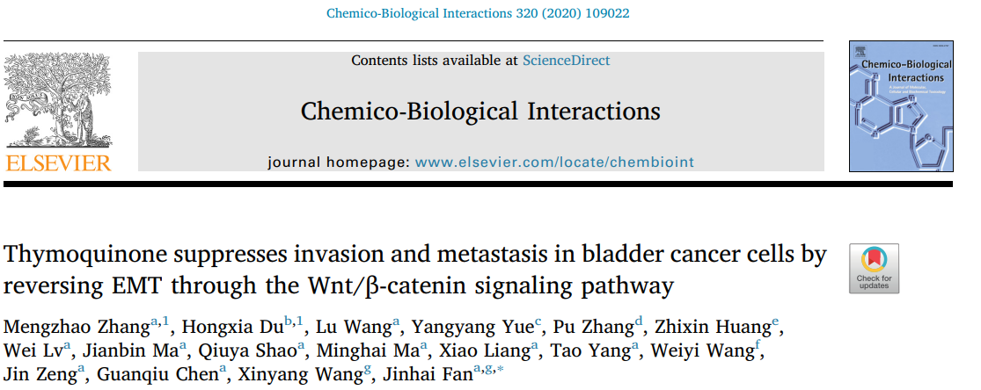
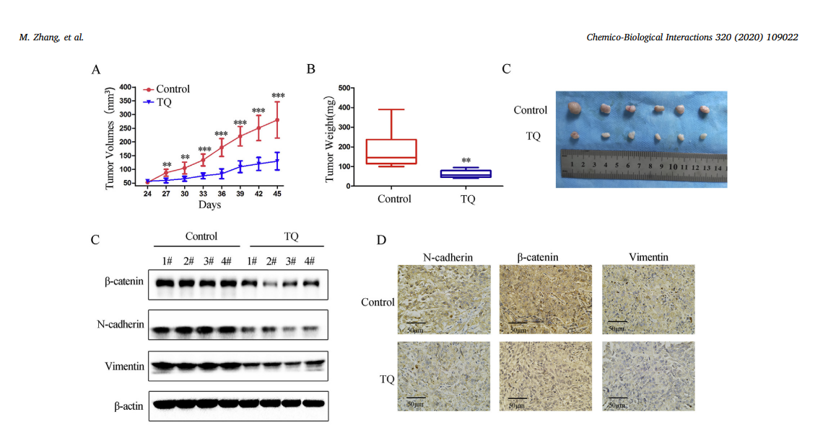

Slide 20
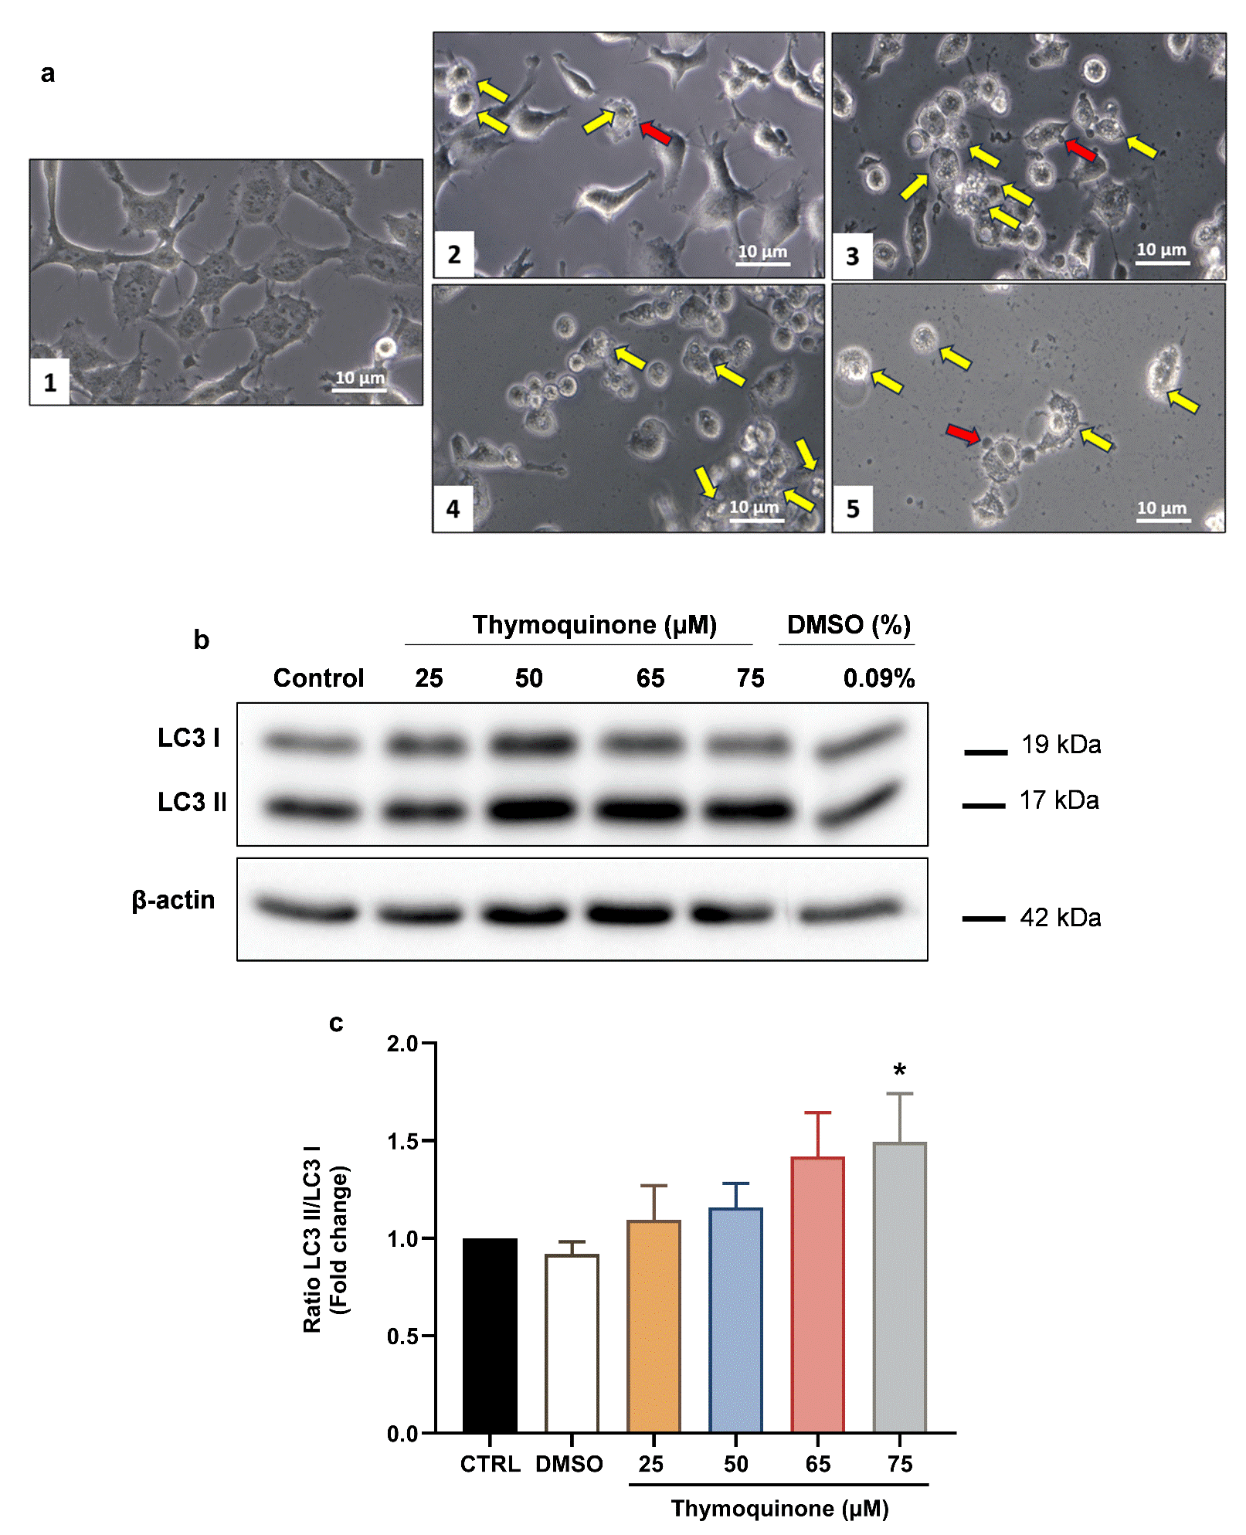
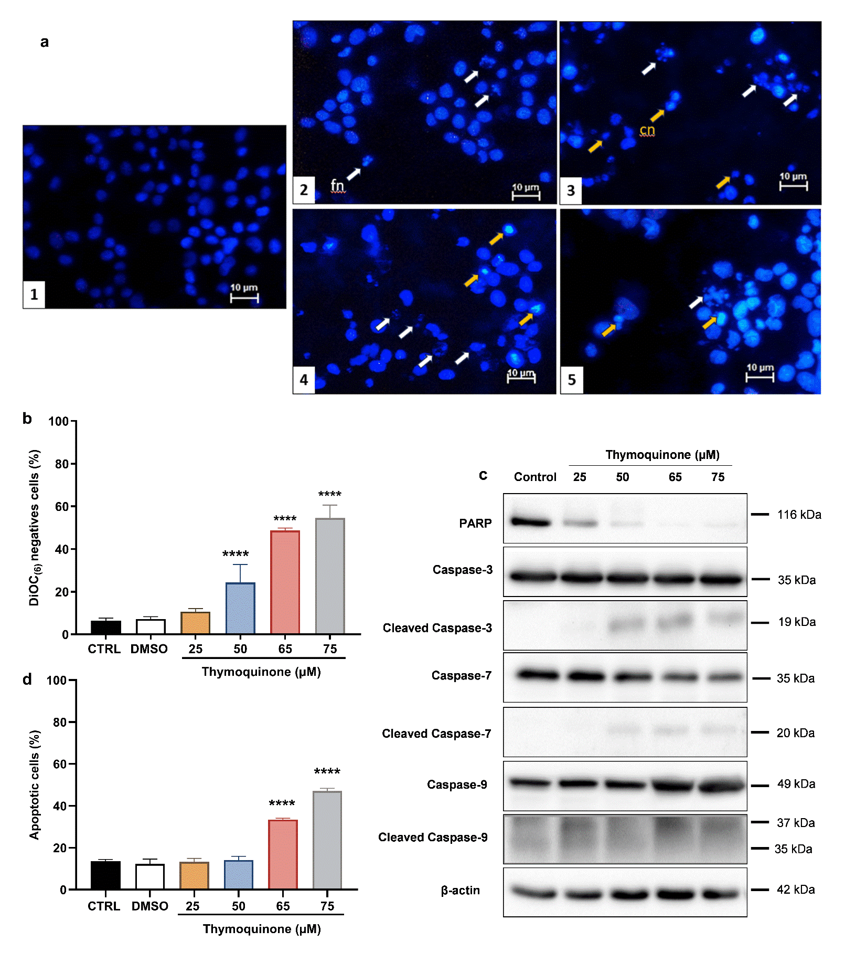
La Thymoquinone induit la mort par apoptose et autophagie de la lignée du cancer du sein TN MDA-MB 231

Slide 21
Questions perspectives ???
l’Année prochaine ???
Quel rôle jouent les CTC dans la voie Wnt ?
Les VEs contiennent elles des éléments de la voie Wnt ?
La TQ agit elle sur la voie Wnt ? ect…

Slide 22
MERCI… aux responsables et membres
Service de radiothérapie, CHU Farhat-Hached, Sousse
Centre Médical Ibn Khaldoun de Sousse
Service Anatomie Et Cytologie Pathologique, CHU Fattouma Bourguiba, Monastir
Laboratoire de Biochimie du peroxysome, inflammation et métabolisme lipidique (Bio-PeroxIL). Faculté des Sciences de Dijon, Université de Bourgogne, France.
Unité Inserm U1307 du Centre de Recherche en Cancérologie et Immunologie Intégrée, Nantes, France.
L’équipe du Laboratoire d’Immuno-Oncologie Moléculaire

